Slide 1
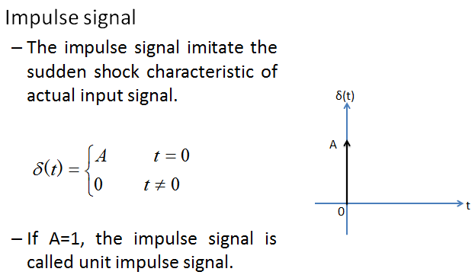
Control Lec. 4
Time Domain Analysis of Control systems
The manner in which a dynamic system responds to an input, expressed as a function of time, is called the time response. The time response of a control system consists of two parts: the transient response and the steady-state response. By transient response, we mean that which goes from the initial state to the final state. By steady-state response, we mean the manner in which the system output behaves as t approaches infinity. Thus the system response c(t) may be written as:
where the first term on the right-hand side of the equation is the transient response and the second term is the steady-state response.
Many design criteria are based on the response to such signals or on the response of systems to changes in initial conditions (without any test signals). The use of test signals can be justified because of a correlation existing between the response characteristics of a system
to a typical test input signal and the capability of the system to cope with actual input signals.
The commonly used test input signals are those of step functions, ramp functions, acceleration functions, impulse functions, sinusoidal functions, and the like. With these test signals, mathematical and experimental analyses of control systems can be carried out easily since the signals are very simple functions of time.
Standard Test Signals:
L{δ (t)} = δ (s) = A

Slide 2
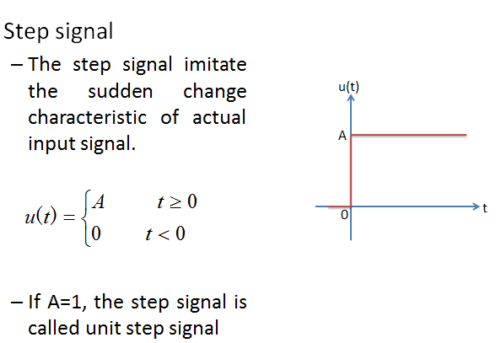
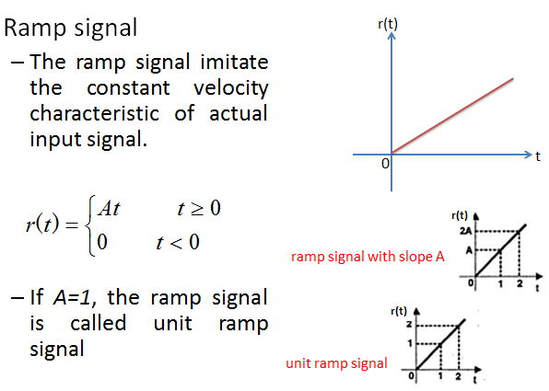
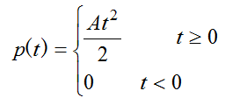
Control Lec. 4
L{u(t)} = U (s) = ^{A}
S
L{r(t)} = R(s) =
A
_{s}2
L{ p(t)} = P(s) = ^{2 A}
_{S} 3

Slide 3
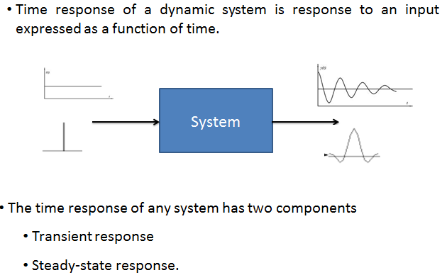
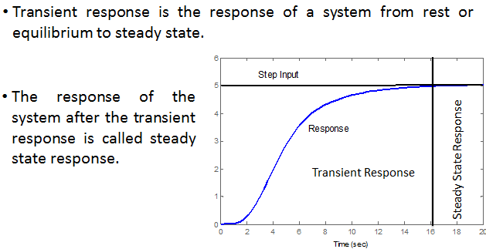
Control Lec. 4
Time Response of Control Systems:

Slide 4
Control Lec. 4
Transient response
1. Transient response of 1st Order Systems
Consider the first-order system shown in Figure 4-l(a). A simplified block diagram is shown in Figure 4-l(b). The input-output relationship is given by:
(4.1)
Figure 4-1(a) Block diagram of a first-order system; (b) simplified block diagram
we shall analyze the system responses to such inputs as the unit-step, unit-ramp, and unit- impulse functions. The initial conditions are assumed to be zero.
a. Unit-Step Response of First-Order Systems. Since the Laplace transform of the unit-step function is l/s, substituting R(s) = 1/s into Equation (4-1), we obtain
Expanding C(s) into partial fractions gives
(4.2)

Slide 5
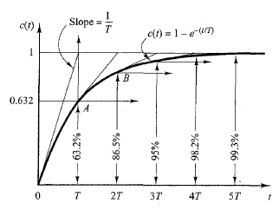
Control Lec. 4
Taking the inverse Laplace transform of Equation (4-2), we obtain
(4.3)
Equation (4-3) states that initially the output c(t) is zero and finally it becomes unity. One important characteristic of such an exponential response curve c(t) is that at t = T the value of c(t) is 0.632, or the response c(t) has reached 63.2% of its total change. This may be easily seen by substituting t = T in c(t). That is,
Note that the smaller the time constant T , the faster the system response. Another important characteristic of the exponential response curve is that the slope of the tangent line at t = 0 is 1 /T.
The exponential response curve c(t) given by Equation (4-3) is shown in Figure 4-2. In one time constant, the exponential response curve has gone from 0 to 63.2% of the final value. In two time constants, the response reaches 86.5% of the final value. At t = 3T, 4T, and 5T, the
response reaches 95%, 98.2%, and 99.3%, respectively, of the final value.
Figure 4-2 Exponential response curve
b. Unit-Ramp Response of First-Order Systems
Since the Laplace transform of the unit-ramp function is l/s2, we obtain the output of the system of Figure 4-l(a) as
Expanding C(s) into partial fractions gives

Slide 6
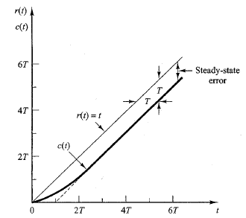
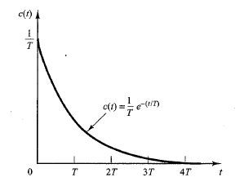
Control Lec. 4
(4.4)
Taking the inverse Laplace transform of Equation (4-4), we obtain
The error signal e(t) is then
Figure 4-3
Unit-ramp response
The unit-ramp input and the system output are shown in Figure 4-3.As t approaches infinity,
e^{-t/T} approaches zero, and thus the error signal e(t) approaches T or
c. Unit-Impulse Response of First-Order Systems
For the unit-impulse input, R(s) = 1 and the output of the system of Figure 4-l(a) can be obtained as:
The inverse Laplace transform of Equation (4-5) gives
The response curve given by above Equation is shown in Figure 4-4.
Figure 4-4

Slide 7
Control Lec. 4
SECOND-ORDER SYSTEMS
we shall obtain the response of a typical second-order control system to a step input, ramp input, and impulse input. Here we consider a servo system as an example of a second-order system. For Servo System
where T is the torque produced by the proportional controller whose gain is K. By taking Laplace transforms of both sides of this last equation, assuming the zero initial conditions, we obtain:
Figure 4-5 Servo system
So the transfer function between C(s) and T(s) is
this transfer function can be modified to that shown in Figure 4-5.The closed-loop transfer function is then obtained as:
Such a system where the closed-loop transfer function possesses two poles is called a second-order system.
T.F can be rewritten as:
The closed-loop poles are complex conjugates if B² - 4JK < 0 and they are real if B² - 4JK ≥
0. In the transient-response analysis, it is convenient to write

Slide 8
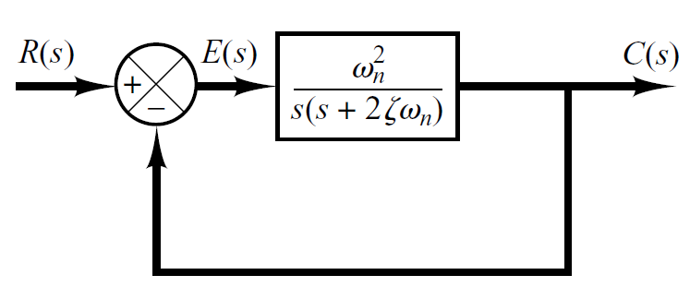
Control Lec. 4
Where
𝜎→ is called the attenuation
The damping ratio is the ratio 𝜻of the actual damping B to the critical damping Bc = 2√�� or
In terms 𝜻of and w_{n} the closed-loop transfer function can be written as:
This form is called the standard form of the second- order system.
Figure 4-6 Second-order
Ex: Determine the un-damped natural frequency and damping ratio of the following
second order system.
C(s) 4
=
R(s) s² + 2s + 4
Sol: Compare the numerator and denominator of the given transfer function with the general 2nd order transfer function.
2
C( s ) ₌
R(s)
ω_{n}
s ² + 2ζω s + ω ²
n n

Slide 9
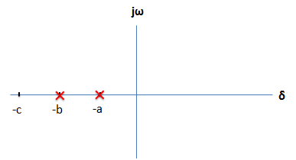
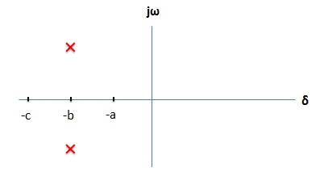
Control Lec. 4
According the value of ζ , a second-order system can be set into one of the four categories:
1- Overdamped - when the system has two real distinct poles ( 𝛇>1 )
In this case, the two poles of C(s)/R(s) are negative real and unequal. For a unit-step input, R(s) = 1/s and C(s) can be written:
The inverse Laplace transform of above Equation is:
2-Underdamped - when the system has two complex conjugate poles (0 < 𝛇<1)
In this case, C(s)/R(s) can be written :

Slide 10
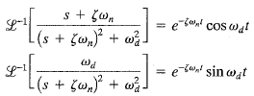
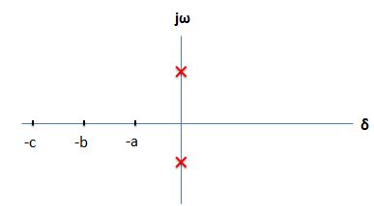
Control Lec. 4
The inverse Laplace transform of above Equation can be obtained easily if C(s) is written in the following form:
Hence
4-1
The error signal for this system is the difference between the input and output and is
3- Undamped - when the system has two imaginary poles ( ζ = 0)
𝑠₁, 𝑠₂ = ±𝑗𝑤_{𝑛}
The response c(t) for the zero damping case may be obtained by substituting ζ = 0 in Equation (4-1), yielding
Page 10

Slide 11
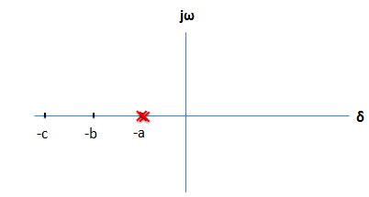
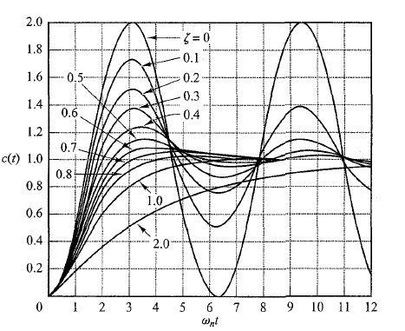
Control Lec. 4
4. Critically damped - when the system has two real but equal poles ( 𝛇= 1)
For a unit-step input, R(s) = l/s and C(s) can be written
The inverse Laplace transform of above Equation is
A family of unit-step response curves c(t) with various values of g is shown in Figure 4-7
Figure 4-7
Time-Domain Specification
For 0< 𝛇<1 and ω_{n} > 0, the 2nd order system’s response due to a unit step input looks like

Slide 12
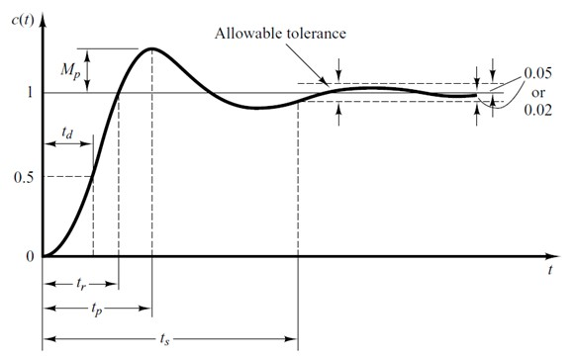
Control Lec. 4

